Slide 1
CS 220 / CS319 Tabular Data (CSV and Spreadsheets)
Department of Computer Sciences
University of Wisconsin-Madison

Slide 2
Learning Objectives Today
CSV format
purpose
syntax
comparison to spreadsheets
Reading CSV files
without header
with header
type casting
Chapter 16 of Sweigart, to (and including) “Reading Data from Reader Objects in a for Loop”
https://automatetheboringstuff.com/2e/chapter16/

Slide 3
Today's Outline
Spreadsheets
CSVs
Reading a CSV to a list of lists
Coding examples

Slide 4
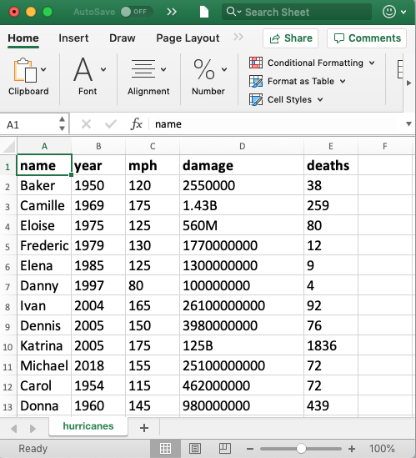
Spreadsheets (e.g., Excel)
Spreadsheets are tables of cells, organized by rows and columns
cells

Slide 5
Spreadsheets (e.g., Excel)
Spreadsheets are tables of cells, organized by rows and columns
columns

Slide 6
Spreadsheets (e.g., Excel)
Spreadsheets are tables of cells, organized by rows and columns
rows

Slide 7
Spreadsheets (e.g., Excel)
Spreadsheets are tables of cells, organized by rows and columns
header

Slide 8
Spreadsheets (e.g., Excel)
Spreadsheets often allow different data types
text
numbers

Slide 9
Spreadsheets (e.g., Excel)
Spreadsheets often allow different fonts, text sizes, colors, highlighting
bold
regular

Slide 10
Spreadsheets (e.g., Excel)
Spreadsheets often support multiple sheets
more tables of data

Slide 11
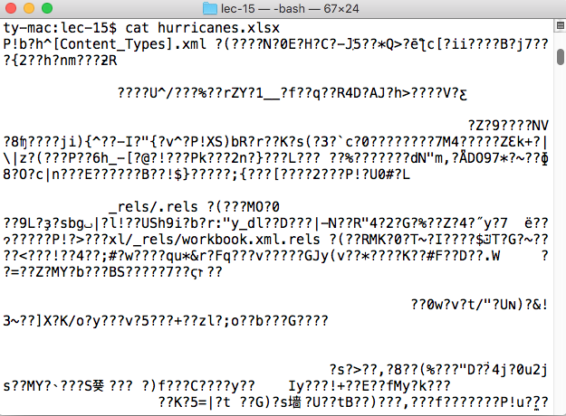
Excel Files
Extension: .xlsx
Format: binary
just 0's and 1's, not human-readable characters.
Need special software…
Writing code to read data from
Excel files is tricky, unless you
use special modules

Slide 12
Today's Outline
Spreadsheets
CSVs
Reading a CSV to a list of lists
Coding examples

Slide 13
CSVs
CSV is a simple data format that stands for Comma-Separated Values
CSVs are like simple spreadsheets
organize cells of data into rows and columns
only one sheet per file
only holds strings
no way to specify font, borders, cell size, etc
we'll do lots of type casting/conversion!

Slide 14
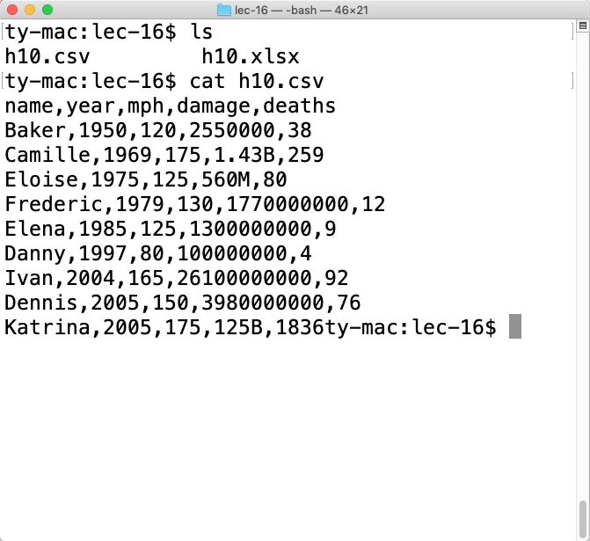
CSV Files
Extension: .csv
Format: plain text
just open in any editor (notepad, textedit, idle, etc) and you’ll be able to read it
Writing code that understands
CSV files is easy

Slide 15
Basic Syntax
Table
Name | Date | Time | Status | Latitude | Longitude | WindSpeed | Ocean
HEIDI | 19671019 | 1200 | TD | 20.5N | 54.0W | 25 | Atlantic
OLAF | 19850822 | 0 | TD | 12.9N | 102.2W | 25 | Pacific
TINA | 19920917 | 1200 | TD | 10.4N | 98.5W | 25 | Pacific
EMMY | 19760820 | 1200 | TD | 14.0N | 48.0W | 20 | Atlantic
Corresponding CSV
Name,Date,Time,Status,Latitude,Longitude,WindSpeed,Ocean
HEIDI,19671019,1200,TD,20.5N,54.0W,25,Atlantic
OLAF,19850822,0,TD,12.9N,102.2W,25,Pacific
TINA,19920917,1200,TD,10.4N,98.5W,25,Pacific
EMMY,19760820,1200,TD,14.0N,48.0W,20,Atlantic
Each row is a line of the file

Slide 16
Basic Syntax
Table
Name | Date | Time | Status | Latitude | Longitude | WindSpeed | Ocean
HEIDI | 19671019 | 1200 | TD | 20.5N | 54.0W | 25 | Atlantic
OLAF | 19850822 | 0 | TD | 12.9N | 102.2W | 25 | Pacific
TINA | 19920917 | 1200 | TD | 10.4N | 98.5W | 25 | Pacific
EMMY | 19760820 | 1200 | TD | 14.0N | 48.0W | 20 | Atlantic
Corresponding CSV
Name,Date,Time,Status,Latitude,Longitude,WindSpeed,Ocean
HEIDI,19671019,1200,TD,20.5N,54.0W,25,Atlantic
OLAF,19850822,0,TD,12.9N,102.2W,25,Pacific
TINA,19920917,1200,TD,10.4N,98.5W,25,Pacific
EMMY,19760820,1200,TD,14.0N,48.0W,20,Atlantic
Cells…

Slide 17
Basic Syntax
Table
Name | Date | Time | Status | Latitude | Longitude | WindSpeed | Ocean
HEIDI | 19671019 | 1200 | TD | 20.5N | 54.0W | 25 | Atlantic
OLAF | 19850822 | 0 | TD | 12.9N | 102.2W | 25 | Pacific
TINA | 19920917 | 1200 | TD | 10.4N | 98.5W | 25 | Pacific
EMMY | 19760820 | 1200 | TD | 14.0N | 48.0W | 20 | Atlantic
Corresponding CSV
Name,Date,Time,Status,Latitude,Longitude,WindSpeed,Ocean
HEIDI,19671019,1200,TD,20.5N,54.0W,25,Atlantic
OLAF,19850822,0,TD,12.9N,102.2W,25,Pacific
TINA,19920917,1200,TD,10.4N,98.5W,25,Pacific
EMMY,19760820,1200,TD,14.0N,48.0W,20,Atlantic
… are separated by commas

Slide 18
Basic Syntax
Table
Name | Date | Time | Status | Latitude | Longitude | WindSpeed | Ocean
HEIDI | 19671019 | 1200 | TD | 20.5N | 54.0W | 25 | Atlantic
OLAF | 19850822 | 0 | TD | 12.9N | 102.2W | 25 | Pacific
TINA | 19920917 | 1200 | TD | 10.4N | 98.5W | 25 | Pacific
EMMY | 19760820 | 1200 | TD | 14.0N | 48.0W | 20 | Atlantic
We call characters that act a separators “delimiters”
Newlines delimit rows
The comma is a delimiter between cells in a row
Corresponding CSV
Name,Date,Time,Status,Latitude,Longitude,WindSpeed,Ocean
HEIDI,19671019,1200, TD,20.5N,54.0W,25,Atlantic
OLAF,19850822,0, TD,12.9N,102.2W,25,Pacific
TINA,19920917,1200, TD,10.4N,98.5W,25,Pacific
EMMY,19760820,1200, TD,14.0N,48.0W,20,Atlantic
… are separated by commas

Slide 19
Advanced Syntax
We won’t go into details here, but there are some complexities
Motivation for more complicated syntax
what if a cell contains a newline?
what if we want a comma inside a cell?
what if a cell contains a quote?
what if we want to use different delimiters between rows/cells?
usually better to use a general CSV module than write our own

Slide 20
Today's Outline
Spreadsheets
CSVs
Reading a CSV to a list of lists
Coding examples

Slide 21
Data Management
3. Python Program
Analysis Code
rows[1][0]
"Baker"
1. spreadsheet in Excel
[
[“name”, “year”, …], [“Baker”, “1950”, …],
…
]
list of lists
Parsing Code
Save As
.CSV
2. CSV file saved somewhere
name,year,mph,damage,deaths
Baker,1950,120,2550000,38
Camille,1969,175,1.43B,259
Eloise,1975,125,560M,80
Frederic,1979,130,1770000000,12

Slide 22
Data Management
3. Python Program
Analysis Code
rows[3][1]
“1975”
1. spreadsheet in Excel
[
[“name”, “year”, …], [“Baker”, “1950”, …],
…
]
list of lists
Parsing Code
Save As
.CSV
2. CSV file saved somewhere
name,year,mph,damage,deaths
Baker,1950,120,2550000,38
Camille,1969,175,1.43B,259
Eloise,1975,125,560M,80
Frederic,1979,130,1770000000,12

Slide 23
Data Management
3. Python Program
Analysis Code
rows[1][-1]
"38"
1. spreadsheet in Excel
[
[“name”, “year”, …], [“Baker”, “1950”, …],
…
]
list of lists
Parsing Code
Save As
.CSV
2. CSV file saved somewhere
name,year,mph,damage,deaths
Baker,1950,120,2550000,38
Camille,1969,175,1.43B,259
Eloise,1975,125,560M,80
Frederic,1979,130,1770000000,12

Slide 24
Data Management
3. Python Program
Analysis Code
rows[0][-2]
"damage"
1. spreadsheet in Excel
[
[“name”, “year”, …], [“Baker”, “1950”, …],
…
]
list of lists
Parsing Code
Save As
.CSV
2. CSV file saved somewhere
name,year,mph,damage,deaths
Baker,1950,120,2550000,38
Camille,1969,175,1.43B,259
Eloise,1975,125,560M,80
Frederic,1979,130,1770000000,12

Slide 25
Data Management
3. Python Program
Analysis Code
rows[0][-2]
"damage"
1. spreadsheet in Excel
[
[“name”, “year”, …], [“Baker”, “1950”, …],
…
]
list of lists
Parsing Code
Parsing Code
Save As
.CSV
2. CSV file saved somewhere
What does this look like?
name,year,mph,damage,deaths
Baker,1950,120,2550000,38
Camille,1969,175,1.43B,259
Eloise,1975,125,560M,80
Frederic,1979,130,1770000000,12

Slide 26
Example Copied From Sweigart Ch 16
import csv
exampleFile = open('example.csv')
exampleReader = csv.reader(exampleFile)
exampleData = list(exampleReader)
Code
4/5/2015 13:34,Apples,73
4/5/2015 3:41,Cherries,85
4/6/2015 12:46,Pears,14
4/8/2015 8:59,Oranges,52
4/10/2015 2:07,Apples,152
4/10/2015 18:10,Bananas,23
4/10/2015 2:40,Strawberries,98
example.csv

Slide 27
Example Copied From Sweigart Ch 16
import csv
exampleFile = open('example.csv')
exampleReader = csv.reader(exampleFile)
exampleData = list(exampleReader)
exampleData
Code
list of
lists
[['4/5/2015 13:34', 'Apples', '73'], ['4/5/2015 3:41', 'Cherries', '85'],
['4/6/2015 12:46', 'Pears', '14'], ['4/8/2015 8:59', 'Oranges', '52'],
['4/10/2015 2:07', 'Apples', '152'], ['4/10/2015 18:10', 'Bananas', '23'],
['4/10/2015 2:40', 'Strawberries', '98']]

Slide 28
Example Copied From Sweigart Ch 16
import csv
exampleFile = open('example.csv')
exampleReader = csv.reader(exampleFile)
exampleData = list(exampleReader)
exampleData
let's generalize this to a function
(don't need to know exactly how the code
works, though we will eventually)

Slide 29
Example Copied From Sweigart Ch 16
import csv
exampleFile = open('example.csv')
exampleReader = csv.reader(exampleFile)
exampleData = list(exampleReader)
exampleData
input
output
let's generalize this to a function
(don't need to know exactly how the code
works, though we will eventually)

Slide 30
Example Copied From Sweigart Ch 16
def process_csv():
import csv
exampleFile = open('example.csv')
exampleReader = csv.reader(exampleFile)
exampleData = list(exampleReader)
exampleData
1. move code to a function

Slide 31
Example Copied From Sweigart Ch 16
import csv
def process_csv():
import csv
exampleFile = open('example.csv')
exampleReader = csv.reader(exampleFile)
exampleData = list(exampleReader)
exampleData
2. move out imports

Slide 32
Example Copied From Sweigart Ch 16
import csv
def process_csv():
import csv
exampleFile = open('example.csv')
exampleReader = csv.reader(exampleFile)
exampleData = list(exampleReader)
exampleFile.close()
return exampleData
3. return data to get it out of the function

Slide 33
Example Copied From Sweigart Ch 16
import csv
def process_csv():
import csv
exampleFile = open('example.csv')
exampleReader = csv.reader(exampleFile)
exampleData = list(exampleReader)
return exampleData
4. generalize input

Slide 34
Example Copied From Sweigart Ch 16
import csv
def process_csv(filename):
import csv
exampleFile = open(filename)
exampleReader = csv.reader(exampleFile)
exampleData = list(exampleReader)
return exampleData
4. generalize input

Slide 35
Example Copied From Sweigart Ch 16
import csv
# copied from https://automatetheboringstuff.com/2e/chapter16/
def process_csv(filename):
import csv
exampleFile = open(filename)
exampleReader = csv.reader(exampleFile)
exampleData = list(exampleReader)
return exampleData
Reminder!
cite code
copied online
5. cite the code

Slide 36
Example Copied From Sweigart Ch 16
import csv
# inspired by https://automatetheboringstuff.com/2e/chapter16/
def process_csv(filename):
example_file = open(filename, encoding="utf-8")
example_reader = csv.reader(example_file)
example_data = list(example_reader)
example_file.close()
return example_data
keep this handy for copy/paste
Encoding required for international computers
We use this file format for all csv files for the class
Remember to close your files

Slide 37
Today's Outline
Spreadsheets
CSVs
Reading a CSV to a list of lists
Coding examples

Slide 38
Example: Student Information Survey
Goal: find the average age of the students, for each lecture
Input:
Student data (a CSV file)
Output:
Average student age for a given lecture
Goal: column name, print that data for all hurricanes
Example: LEC001: 18.5 LEC002: 18.2 LEC003: 18.6 …

Slide 39
Challenge: Hurricane Column Dump
Goal: column name, print that data for all hurricanes
Input:
column name (and a CSV file)
Output:
data in given column, associated with name
Example: Baker: 1950 Camille: 1969 Eloise: 1975 …

Slide 40
Challenge: Hurricanes per Year
Goal: column name, print that data for all hurricanes
Input:
none typed (only a CSV file)
Output:
the number of hurricanes in each year
Example: 1967: 23 1968: 29 2969: 15 …

